Slide 1
Unit - V
File Organization

Slide 2
File organization refers to the way data is stored in a file. File organization is very important because it determines the methods of access, efficiency, flexibility and storage devices to use. 1. Sequential access file organization 2. Random access
Direct addressing
Directory lookup and
Hashing. 3. Linked organization
Multi list
Coral rings Inverted files Cellular partitions
File organization

Slide 3
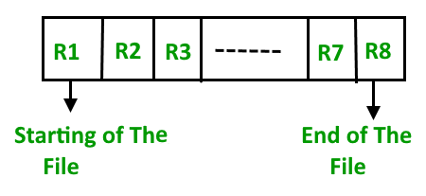
Sequential access file organization
In sequential access file organization, all records are stored in a sequential order. The records are arranged in the ascending or descending order of a key field.
Sequential file search starts from the beginning of the file and the records can be added at the end of the file.
In sequential file, it is not possible to add a record in the middle of the file without rewriting the file.

Slide 4
Pros and Cons of Sequential File Organization
Pros –
Fast and efficient method for huge amount of data.
Simple design.
Files can be easily stored in magnetic tapes i.e cheaper storage mechanism.
Cons –
Time wastage as we cannot jump on a particular record that is required, but we have to move in a sequential manner which takes our time.

Slide 5
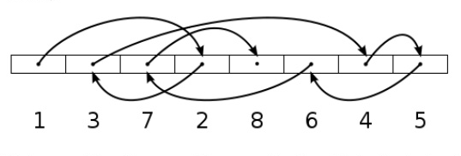
Random Organization
In this organization, records are stored at random locations on disk. This randomization could be achieved by any one of several techniques. Some of these techniques are
Direct addressing
Directory lookup and
Hashing.

Slide 6
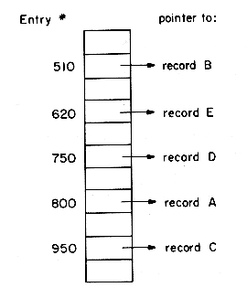
Direct Addressing
In direct addressing with equal size records, the available disk space is divided out into nodes large enough to hold a record. The numeric value of the primary key is used to determine the node into which a particular record is to be stored. No index on this key is needed. With primary key = Employee #, the record for Employee # = 259 will be stored in node 259.

Slide 7
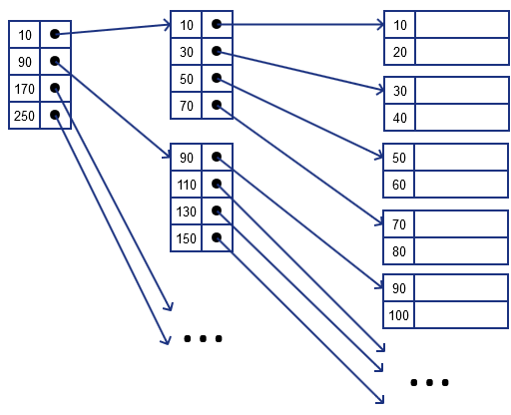
Directory LookUp
Retrieving a record involves searching the index for the record address and then accessing the record itself.

Slide 8
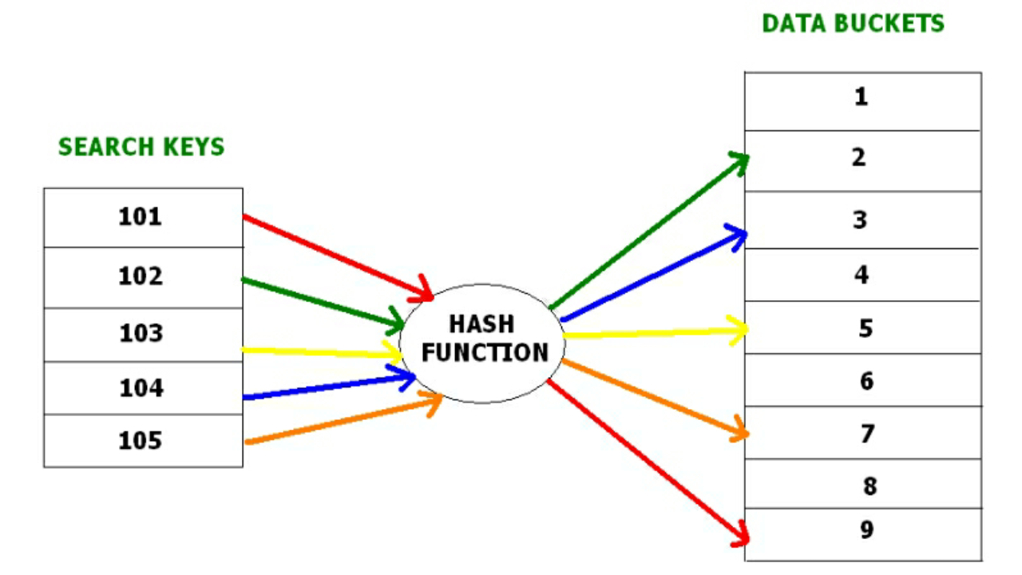
Hashing
Hashing is a technique or process of mapping keys, values into the hash table by using a hash function. The hash function can be any simple or complex mathematical function. The hash function is applied on some columns/attributes – either key or non-key columns to get the bucket address.

Slide 9
Linked organization
Insertions and deletions can be done easily without requiring any movement .
More space is required for the pointers which are also stored along with information.
Size is not fixed.
It can be extended or reduced according to requirements.
Different amount of time is required to access every element.

Slide 10
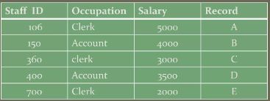
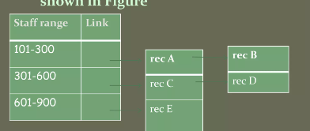
Multi list

Slide 11
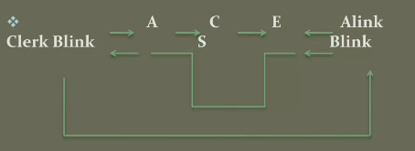
Coral Rings
The coral ring structure is an adaptation of the doubly linked multilist structure discussed above. Each list is structured as a circular list with a headnode.

Slide 12
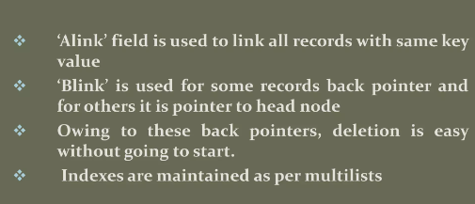

Slide 13
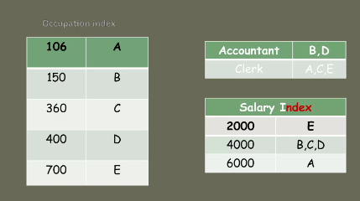
Inverted files
Inverted files are similar to multilists. Inverted files represent one extreme of file organization in which only the index structures are important. The records themselves can be stored in any way.

Slide 14
Cellular partition
To reduce the file search times, the storage media may be divided into cells. A cell may be an entire disk pack or it may simply be a cylinder. Lists are localized to lie within a cell.

